Slide 1

Introduction To Optimization
Tutorial 2 – The Differential & The Gradient

Slide 2
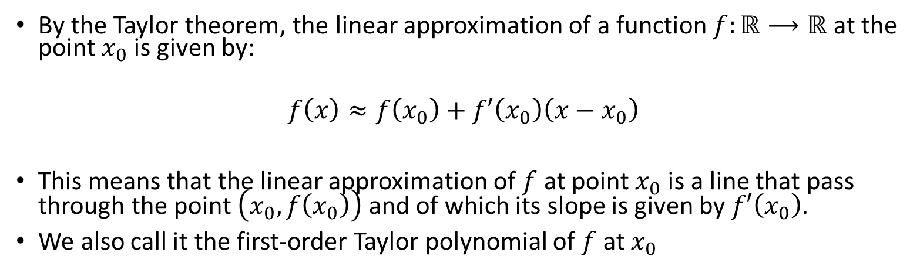
Linear Approximation
By the Taylor theorem, the linear approximation of a function $f:ℝ⟶ℝ$ at the point $x_{0}$ is given by:
$$f\left(x\right)≈f\left(x_{0}\right)+f′\left(x_{0}\right)\left(x−x_{0}\right)$$
This means that the linear approximation of $f$ at point $x_{0}$ is a line that pass through the point $\left(x_{0},f\left(x_{0}\right)\right)$ and of which its slope is given by $f′\left(x_{0}\right)$.
We also call it the first-order Taylor polynomial of $f$at $x_{0}$

Slide 3




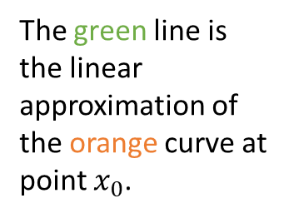


Linear Approximation
$$f\left(x\right)$$
The orange curve represents a function above the real axis.
The green line is the linear approximation of the orange curve at point $x_{0}$.
$$f\left(x_{0}\right)$$
$$\left(x_{0},f\left(x_{0}\right)\right)$$
$$x_{0}$$
$$x$$

Slide 4



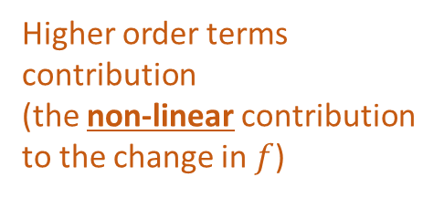

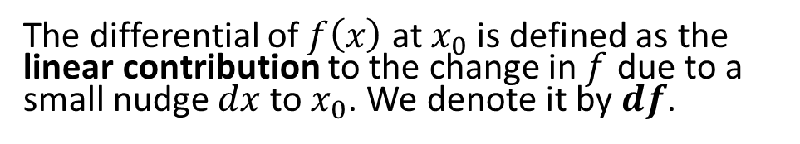









The Differential
The differential of $f\left(x\right)$ at $x_{0}$ is defined as the linear contribution to the change in $f$ due to a small nudge $dx$ to $x_{0}$. We denote it by $df$.
$$df=\left(f\left(x_{0}\right)+f^{′}\left(x_{0}\right)\left(\left(x_{0}+dx\right)−x_{0}\right)\right)−\left(f\left(x_{0}\right)+f^{′}\left(x_{0}\right)\left(x_{0}−x_{0}\right)\right)=f^{′}\left(x_{0}\right)dx$$
$$f\left(x\right)$$
$$f\left(x_{0}\right)+f′\left(x_{0}\right)\left(x−x_{0}\right)$$
$$∆f=f\left(x_{0}+dx\right)−f\left(x_{0}\right)=df+o\left(dx\right)$$
$$f\left(x_{0}+dx \right)$$
$$o\left(dx\right)$$
$$∆f$$
$$df$$
$$f\left(x_{0}\right)$$
$$dx$$
Linear term (the linear contribution to the change in $f$)
Higher order terms contribution (the non-linear contribution to the change in $f$)
$$x_{0}$$
$$x_{0}+dx$$
$$x$$

Slide 5

The external definition of the derivative
The relationship $df=f′\left(x_{0}\right)dx$ can be thought as the “external” definition of the derivative.
This means that if we’re given $df=c∙dx$ as the linear contribution of the change of a function $f$ at $x_{0}$ due to a small nudge $dx$, we can immediately deduce that $c=f′\left(x_{0}\right)$.

Slide 6
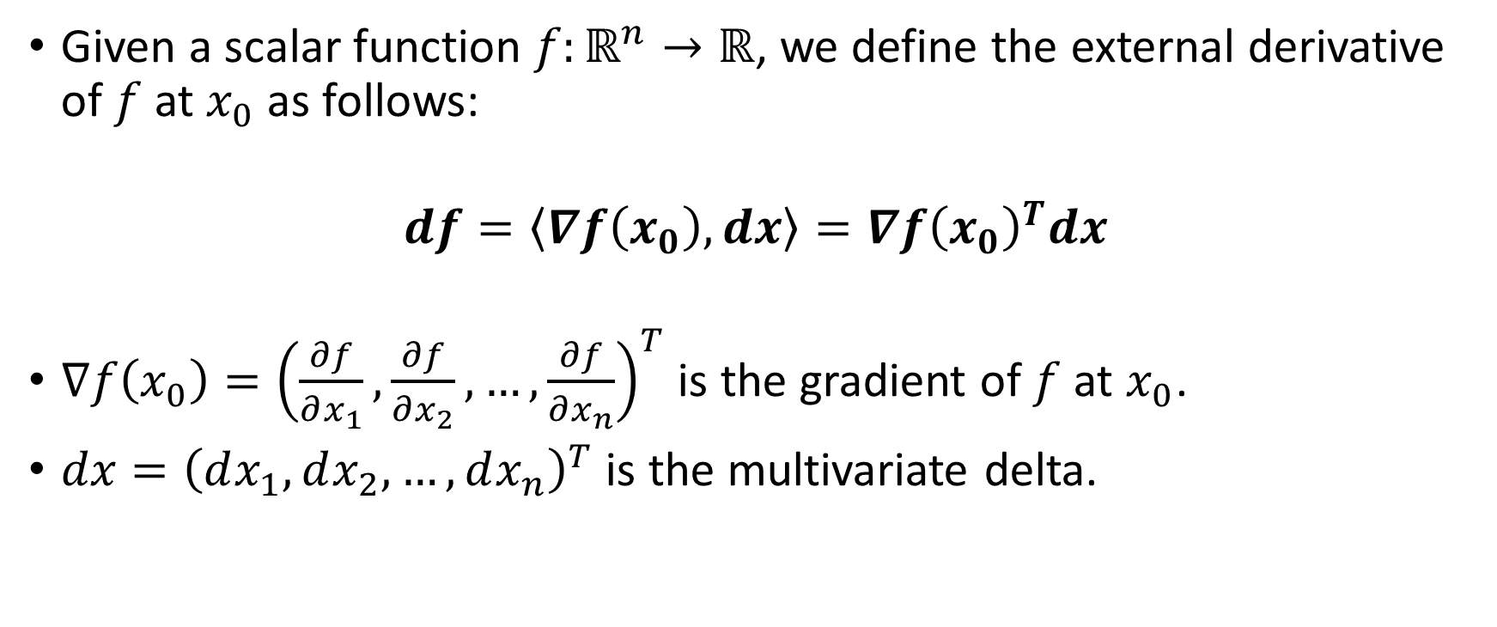
Extension of the external definition of the derivative to multivariable scalar functions
Given a scalar function $f:ℝ^{n}→ℝ$, we define the external derivative of $f$ at $x_{0}$ as follows:
$$df=\left\langle ∇f\left(x_{0}\right),dx\right\rangle ={∇f\left(x_{0}\right)}^{T}dx$$
$∇f\left(x_{0}\right)={\left(\frac{∂f}{∂x_{1}},\frac{∂f}{∂x_{2}},…,\frac{∂f}{∂x_{n}}\right)}^{T}$ is the gradient of $f$ at $x_{0}$.
$dx={\left(dx_{1},dx_{2},…,dx_{n}\right)}^{T}$ is the multivariate delta.

Slide 7
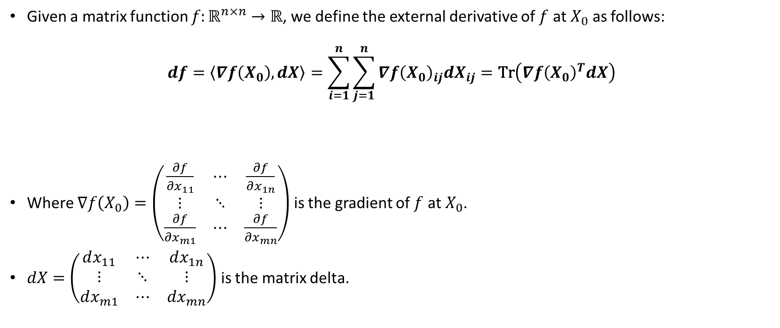
Extension of the external definition of the derivative to matrix scalar functions
Given a matrix function $f:ℝ^{n×n}→ℝ$, we define the external derivative of $f$ at $X_{0}$ as follows:
$$df=\left\langle ∇f\left(X_{0}\right),dX\right\rangle =\sum_{i=1}^{n}{\sum_{j=1}^{n}{{∇f\left(X_{0}\right)}_{ij}{dX}_{ij}}}=\text{Tr}\left({∇f\left(X_{0}\right)}^{T}dX\right)$$
Where $∇f\left(X_{0}\right)=\left(\begin{matrix}\frac{∂f}{∂x_{11}} & ⋯ & \frac{∂f}{∂x_{1n}} \\ ⋮ & ⋱ & ⋮ \\ \frac{∂f}{∂x_{m1}} & ⋯ & \frac{∂f}{∂x_{mn}}\end{matrix}\right)$ is the gradient of $f$ at $X_{0}$.
$dX=\left(\begin{matrix}dx_{11} & ⋯ & dx_{1n} \\ ⋮ & ⋱ & ⋮ \\ dx_{m1} & ⋯ & dx_{mn}\end{matrix}\right)$ is the matrix delta.

Slide 8

Product and sum rules of Differentials
$d\left(f\left(x\right)+g\left(x\right)\right)=dg\left(x\right)+df\left(x\right)$
$d\left(f\left(x\right)g\left(x\right)\right)=f\left(x\right)dg\left(x\right)+df\left(x\right)g\left(x\right)$

Slide 9
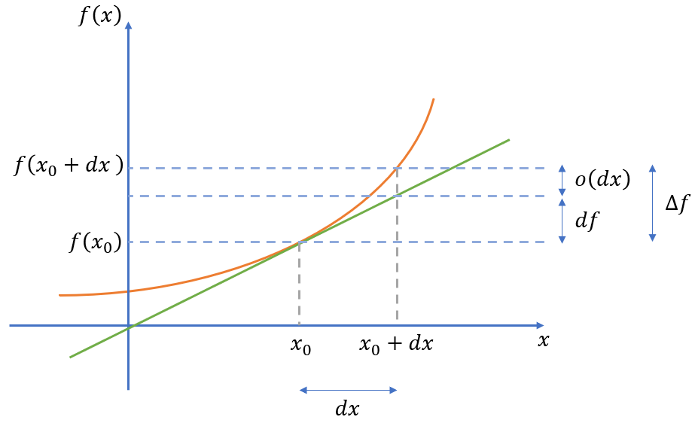





Derivation of product rule
$$h\left(x\right)=f\left(x\right)g\left(x\right)$$
$$∆\left(h\left(x_{0}\right)\right)=$$
$$h\left(x_{0}+dx\right)−h\left(x_{0}\right)=$$
$$f\left(x_{0}+dx\right)g\left(x_{0}+dx\right)−f\left(x_{0}\right)g\left(x_{0}\right)=$$
$$f\left(x_{0}+dx\right)g\left(x_{0}+dx\right)+\underset{=0}{\underbrace{f\left(x_{0}+dx\right)g\left(x_{0}\right)−f\left(x_{0}+dx\right)g\left(x_{0}\right)}}−f\left(x_{0}\right)g\left(x_{0}\right)=$$
$$f\left(x_{0}+dx\right)\left(g\left(x_{0}+dx\right)−g\left(x_{0}\right)\right)+\left(f\left(x_{0}+dx\right)−f\left(x_{0}\right)\right)g\left(x_{0}\right)=$$
$$d\left(f\left(x\right)g\left(x\right)\right)=f\left(x\right)dg\left(x\right)+df\left(x\right)g\left(x\right)$$
$$f\left(x_{0}+dx\right)∆g\left(x_{0}\right)+∆f\left(x_{0}\right)g\left(x_{0}\right)=$$
$$\left(f\left(x_{0}\right)+∆f\left(x_{0}\right)\right)∆g\left(x_{0}\right)+∆f\left(x_{0}\right)g\left(x_{0}\right)=$$
Red = Non-linear terms
Green = Linear terms
$$\left(f\left(x_{0}\right)+df\left(x_{0}\right)+o\left(dx\right)\right)\left(dg\left(x_{0}\right)+o\left(dx\right)\right)+\left(df\left(x_{0}\right)+o\left(dx\right)\right)g\left(x_{0}\right)=$$
$$f\left(x_{0}\right)dg\left(x_{0}\right)+f\left(x_{0}\right)o\left(dx\right)+df\left(x_{0}\right)dg\left(x_{0}\right)+df\left(x_{0}\right)o\left(dx\right)+o\left(dx\right)dg\left(x_{0}\right)+o\left(dx\right)o\left(dx\right)+df\left(x_{0}\right)g\left(x_{0}\right)+o\left(dx\right)g\left(x_{0}\right)$$

Slide 10

Frobenius Norm
The Frobenius norm is the extension of the 2-norm to matrices:
$${\left\|A\right\|}_{F}=\sqrt{\sum_{i}{\sum_{j}{{a_{ij}}^{2}}}}=\sqrt{\text{Tr}\left(A^{T}A\right)}$$

Slide 11
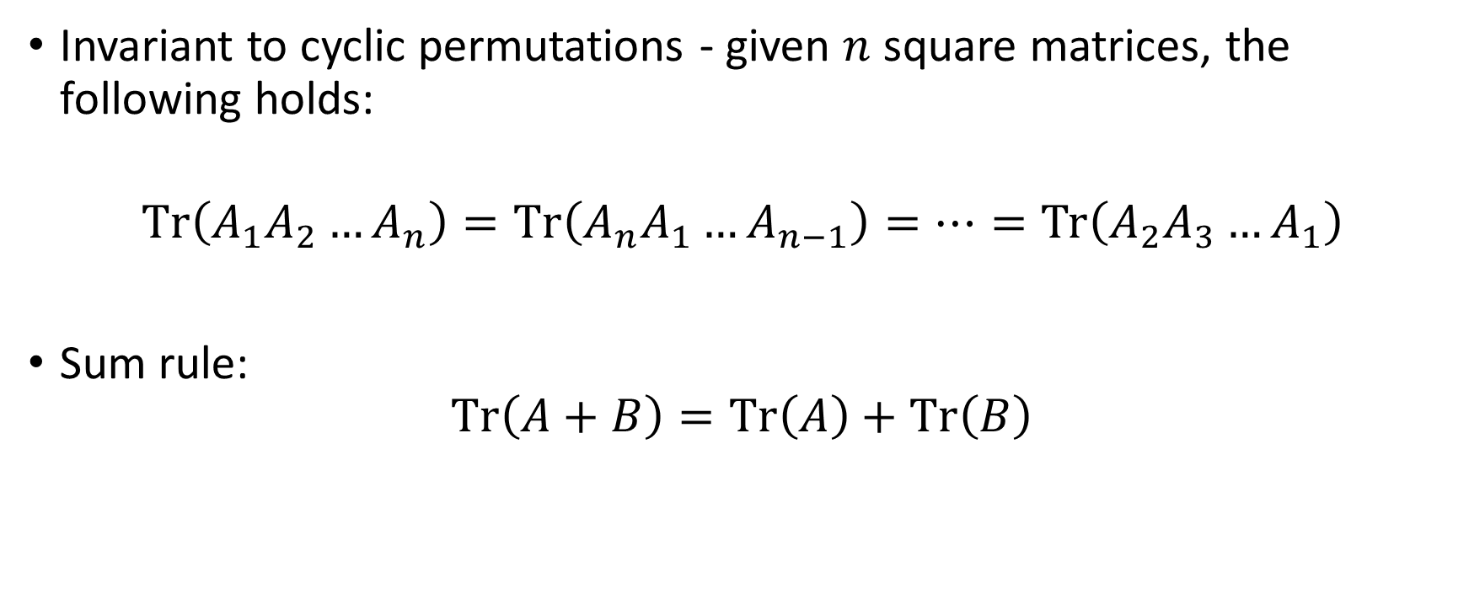
Properties of matrix trace
Invariant to cyclic permutations - given $n$ square matrices, the following holds:
$$\text{Tr}\left(A_{1}A_{2}…A_{n}\right)=\text{Tr}\left(A_{n}A_{1}…A_{n−1}\right)=…=\text{Tr}\left(A_{2}A_{3}…A_{1}\right)$$
Sum rule:
$$\text{Tr}\left(A+B\right)=\text{Tr}\left(A\right)+\text{Tr}\left(B\right)$$

Slide 12

Exercise 1
Let $X$be a square matrix. Show that $d\left(\text{Tr}\left(X\right)\right)=\text{Tr}\left(dX\right)$.

Slide 13
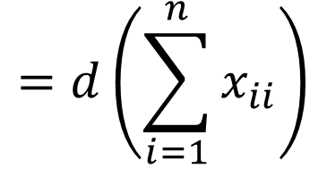
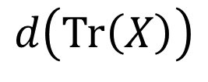
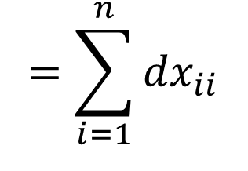
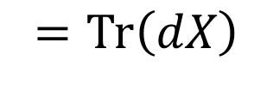
Exercise 1 - Solution
$$=d\left(\sum_{i=1}^{n}{x_{ii}}\right)$$
$$=\sum_{i=1}^{n}{{dx}_{ii}}$$
$$d\left(\text{Tr}\left(X\right)\right)$$
$$=\text{Tr}\left(dX\right)$$

Slide 14

Exercise 2
Let $f\left(X\right)=\frac{1}{2}{\left\|Y−AX\right\|}_{F}^{2}$ be a matrix function, such that $X,Y,A$be a square matrices. Find the gradient of $f$.

Slide 15
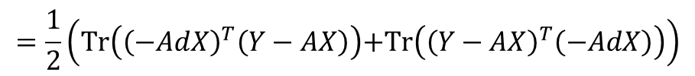

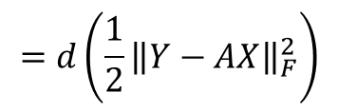
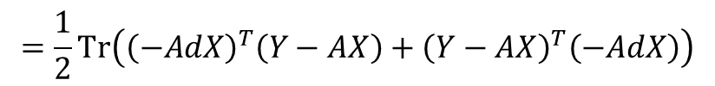


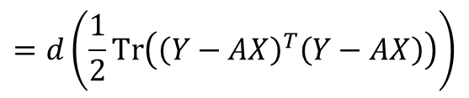
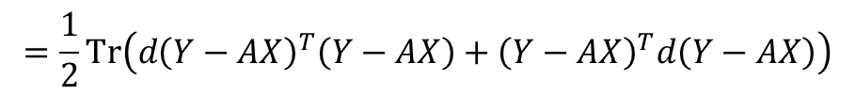

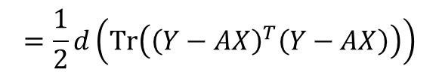
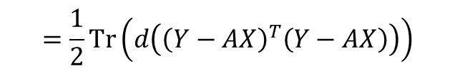

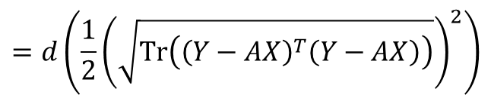
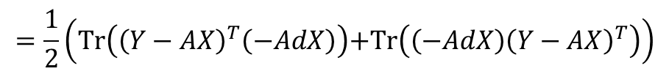

Exercise 2 - Solution
$$=d\left(\frac{1}{2}{\left\|Y−AX\right\|}_{F}^{2}\right)$$
$$=d\left(\frac{1}{2}{\left(\sqrt{\text{Tr}\left({\left(Y−AX\right)}^{T}\left(Y−AX\right)\right)}\right)}^{2}\right)$$
$$=d\left(\frac{1}{2}\text{Tr}\left({\left(Y−AX\right)}^{T}\left(Y−AX\right)\right)\right)$$
$$df\left(X\right)$$
$$=\frac{1}{2}d\left(\text{Tr}\left({\left(Y−AX\right)}^{T}\left(Y−AX\right)\right)\right)$$
$$=\frac{1}{2}\text{Tr}\left(d\left({\left(Y−AX\right)}^{T}\left(Y−AX\right)\right)\right)$$
$$=\frac{1}{2}\text{Tr}\left(d{\left(Y−AX\right)}^{T}\left(Y−AX\right)+{\left(Y−AX\right)}^{T}d\left(Y−AX\right)\right)$$
$$=\frac{1}{2}\text{Tr}\left({\left(−AdX\right)}^{T}\left(Y−AX\right)+{\left(Y−AX\right)}^{T}\left(−AdX\right)\right)$$
$$=\frac{1}{2}\left(\text{Tr}\left({\left(−AdX\right)}^{T}\left(Y−AX\right)\right)\text{+}\text{Tr}\left({\left(Y−AX\right)}^{T}\left(−AdX\right)\right)\right)$$
$$=\frac{1}{2}\left(\text{Tr}\left({\left(Y−AX\right)}^{T}\left(−AdX\right)\right)\text{+}\text{Tr}\left(\left(−AdX\right){\left(Y−AX\right)}^{T}\right)\right)$$
$$=\text{Tr}\left({\left(Y−AX\right)}^{T}\left(−AdX\right)\right)$$
$$=\text{Tr}\left(−{\left(Y−AX\right)}^{T}AdX\right)$$
$$=\text{Tr}\left({\left(−A^{T}\left(Y−AX\right)\right)}^{T}dX\right)$$
$$=\left\langle −A^{T}\left(Y−AX\right),dX\right\rangle$$
$$∇f\left(X\right)=−A^{T}\left(Y−AX\right)$$

Slide 16

Exercise 3
Let $X$be a square matrix. We define $f\left(X\right)=\sum_{i}{λ_{i}\left(X\right)}$. That is, given a square matrix $X$, the function $f$ returns the sum of its eigenvalues. Find the gradient of $f$.

Slide 17

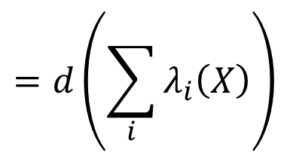





Exercise 3 - Solution
$$=d\left(\sum_{i}{λ_{i}\left(X\right)}\right)$$
$$df\left(X\right)$$
$$=d\left(\text{Tr}\left(X\right)\right)$$
$$=\text{Tr}\left(dX\right)$$
$$=\text{Tr}\left(I^{T}dX\right)$$
$$=\left\langle I,dX\right\rangle$$
$$∇f\left(X\right)=I$$

Slide 18

Exercise 4
Let $X$be a square symmetric matrix. We define $f\left(X\right)=\text{Tr}\left(X^{k}\right)$ for some $k∈ℕ^{+}$. Find the gradient of $f$.

Slide 19








Exercise 4 - Solution
$$d\left(f\left(X\right)\right)$$
$$=d\left(\text{Tr}\left(X^{k}\right)\right)$$
$$=\text{Tr}\left(d\left(X^{k}\right)\right)$$
$$=\text{Tr}\left(d\left(\underset{k times}{\underbrace{X∙X∙…∙X}}\right)\right)$$
$$=\text{Tr}\left(dX∙X∙…∙X+X∙dX∙…∙X+…+X∙X∙…∙dX\right)$$
$$=\text{Tr}\left(dX∙X∙…∙X\right)+\text{Tr}\left(X∙dX∙…∙X\right)+…+\text{Tr}\left(X∙X∙…∙dX\right)$$
$$=\text{Tr}\left(X^{k−1}dX\right)+\text{Tr}\left(X^{k−1}dX\right)+…+\text{Tr}\left(X^{k−1}dX\right)$$
$$=\text{Tr}\left(kX^{k−1}dX\right)$$
$$=\text{Tr}\left({\left(kX^{k−1}\right)}^{T}dX\right)$$
$$=\left\langle kX^{k−1},dX\right\rangle$$
$$∇f\left(X\right)=kX^{k−1}$$

